Slide 1
Property Together
Tokenized Commercial Real Estate Marketplace

Slide 2
Problems
Crypto Volatility
Lack of Global Access
Lack of Liquidity

Slide 3
Solution
Global Access
Income Properties
Liquidity Tokenize Each Property

Slide 4
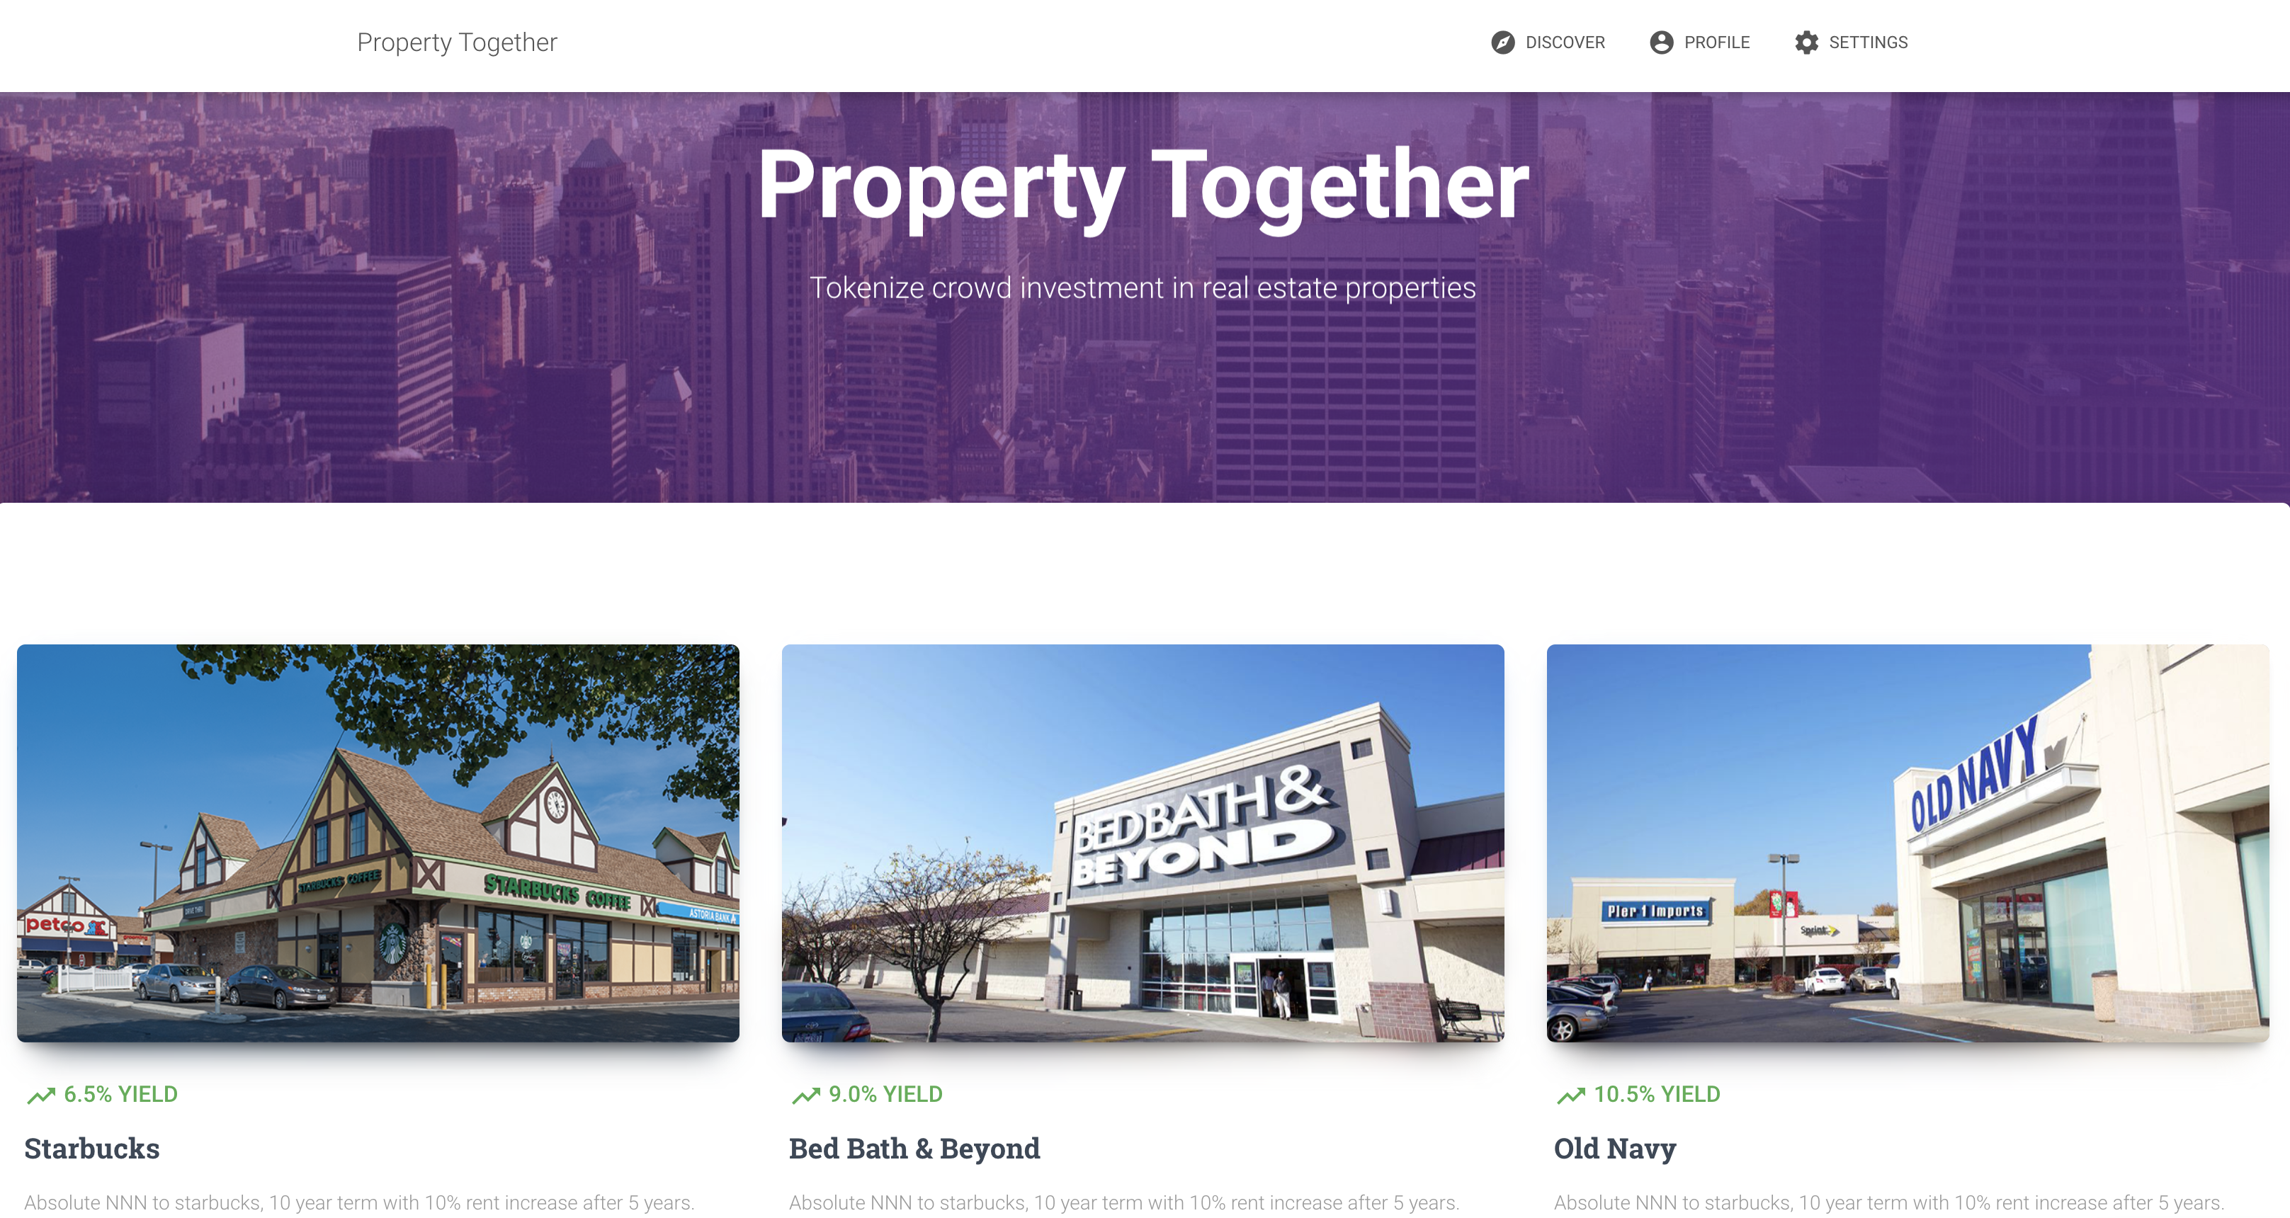

Slide 5
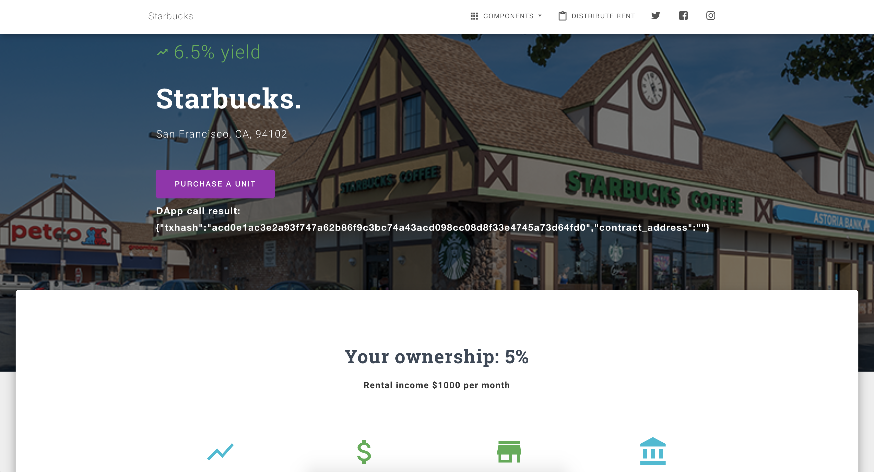

Slide 6
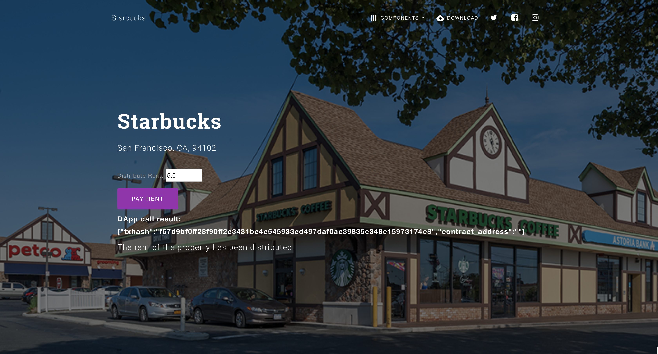

Slide 7
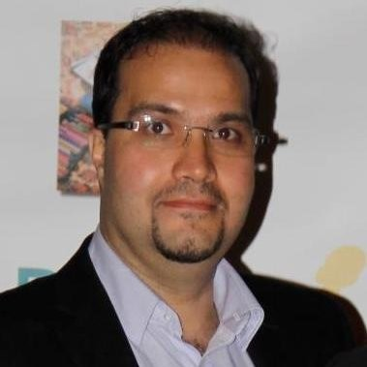
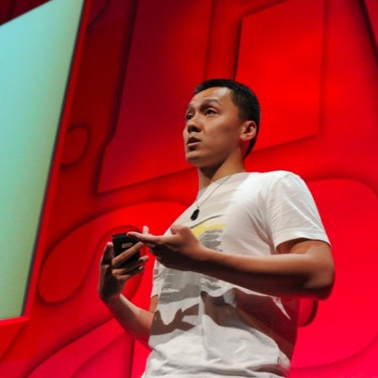
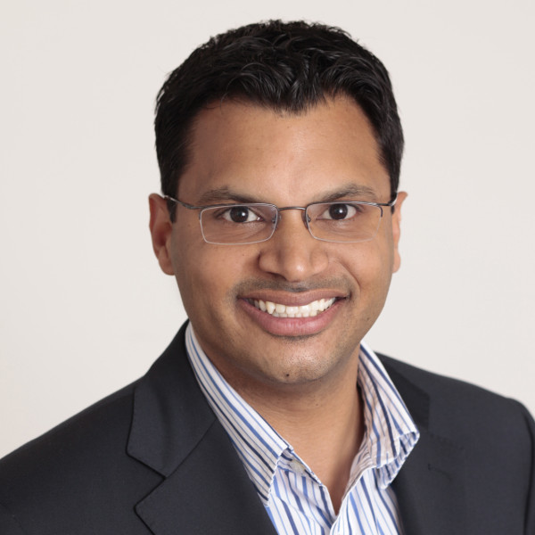
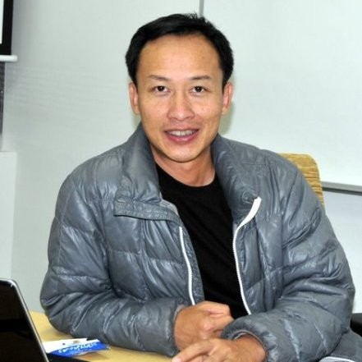
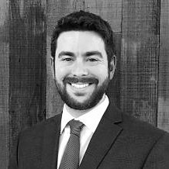
Team
Amir Youssefi
Chief Data Engineer
PayPal
Peter Ma Prototyping expert
Manny Fernandez
Real estate investor, tech entrepreneur
Kenneth Ng
Sr. Software Architect
Robert Loebl
Certified Commercial Investment Member (CCIM)
Solomon Wu
Blockchain Pioneer

